Slide 1
Chapter 14
The Preprocessor

Slide 2
Introduction
Directives such as #define and #include are handled by the preprocessor, a piece of software that edits C programs just prior to compilation.
Its reliance on a preprocessor makes C (along with C++) unique among major programming languages.
The preprocessor is a powerful tool, but it also can be a source of hard-to-find bugs.

Slide 3
How the Preprocessor Works
The preprocessor looks for preprocessing directives, which begin with a # character.
We’ve encountered the #define and #include directives before.
#define defines a macro - a name that represents something else, such as a constant.
The preprocessor responds to a #define directive by storing the name of the macro along with its definition.
When the macro is used later, the preprocessor “expands” the macro, replacing it by its defined value.

Slide 4
How the Preprocessor Works
#include tells the preprocessor to open a particular file and “include” its contents as part of the file being compiled.
For example, the line
#include <stdio.h>
instructs the preprocessor to open the file named stdio.h and bring its contents into the program.

Slide 5
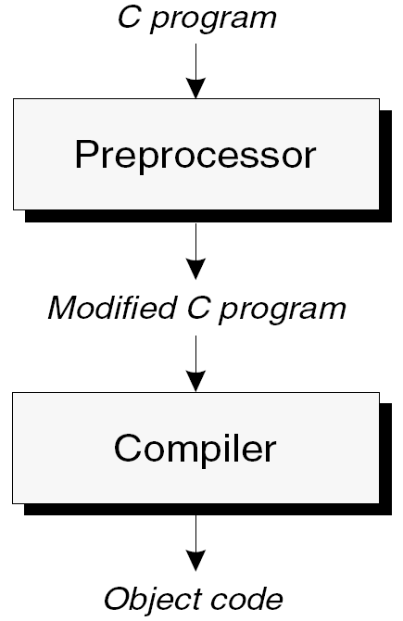
How the Preprocessor Works
The preprocessor’s role in the compilation process:

Slide 6
How the Preprocessor Works
The input to the preprocessor is a C program, possibly containing directives.
The preprocessor executes these directives, removing them in the process.
The preprocessor’s output goes directly into the compiler.

Slide 7
The celsius.c program of Chapter 2:
01) | /* Converts a Fahrenheit temperature to Celsius */
02) | #include <stdio.h>
03)
04) | #define FREEZING_PT 32.0f
05) | #define SCALE_FACTOR (5.0f / 9.0f)
06)
07) | int main(void)
08) | {
09) | float fahrenheit, celsius;
10)
11) | printf("Enter Fahrenheit temperature: ");
12) | scanf("%f", &fahrenheit);
13)
14) | celsius = (fahrenheit - FREEZING_PT) * SCALE_FACTOR;
15) | printf("Celsius equivalent is: %.1f\n", celsius);
16)
17) | return 0;
18) | }

Slide 8
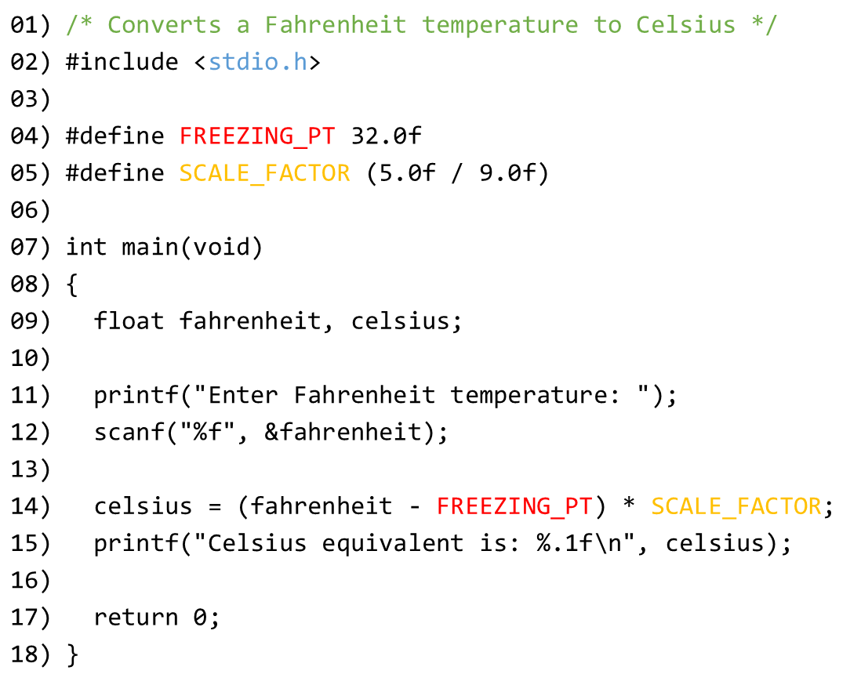
After preprocess:
01) | {Blank Line}
02) | Lines brought in from stdio.h
03) | {Blank Line}
04) | {Blank Line}
05) | {Blank Line}
06) | {Blank Line}
07) | int main(void)
08) | {
09) | float fahrenheit, celsius;
10)
11) | printf("Enter Fahrenheit temperature: ");
12) | scanf("%f", &fahrenheit);
13)
14) | celsius = (fahrenheit – 32.0f) * (5.0f / 9.0f);
15) | printf("Celsius equivalent is: %.1f\n", celsius);
16)
17) | return 0;
18) | }

Slide 9
How the Preprocessor Works
The preprocessor does a bit more than just execute directives.
In particular, it replaces each comment with a single space character.
Some preprocessors go further and remove unnecessary white-space characters, including spaces and tabs at the beginning of indented lines.

Slide 10
How the Preprocessor Works
In the early days of C, the preprocessor was a separate program.
Nowadays, the preprocessor is often part of the compiler, and some of its output may not necessarily be C code.
Still, it’s useful to think of the preprocessor as separate from the compiler.

Slide 11
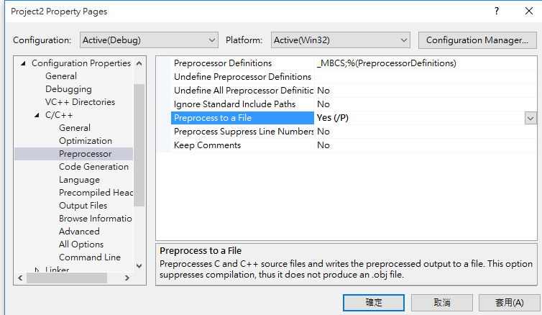
How the Preprocessor Works
Most C compilers provide a way to view the output of the preprocessor.
Some compilers generate preprocessor output when a certain option is specified (GCC will do so when the -E option is used).
Others come with a separate program that behaves like the integrated preprocessor.
Options in Visual Studio

Slide 12
How the Preprocessor Works
A word of caution: The preprocessor has only a limited knowledge of C.
As a result, it’s quite capable of creating illegal programs as it executes directives.
In complicated programs, examining the output of the preprocessor may prove useful for locating this kind of error.

Slide 13
Preprocessing Directives
Most preprocessing directives fall into one of three categories:
Macro definition. The #define directive defines a macro; the #undef directive removes a macro definition.
File inclusion. The #include directive causes the contents of a specified file to be included in a program.
Conditional compilation. The #if, #ifdef, #ifndef, #elif, #else, and #endif directives allow blocks of text to be either included in or excluded from a program.

Slide 14
Preprocessing Directives
Several rules apply to all directives.
Directives always begin with the # symbol. The # symbol need not be at the beginning of a line, as long as only white space precedes it.
Any number of spaces and horizontal tab characters may separate the tokens in a directive. Example:
#define N 100

Slide 15
Preprocessing Directives
Directives always end at the first new-line character, unless explicitly continued.
To continue a directive to the next line, end the current line with a \ character:
#define DISK_CAPACITY (SIDES * \
TRACKS_PER_SIDE * \
SECTORS_PER_TRACK * \
BYTES_PER_SECTOR)

Slide 16
Preprocessing Directives
Directives can appear anywhere in a program.
Although #define and #include directives usually appear at the beginning of a file, other directives are more likely to show up later.
Comments may appear on the same line as a directive.
It’s good practice to put a comment at the end of a macro definition:
#define FREEZING_PT 32.0f /* freezing point of water */

Slide 17
Macro Definitions
The macros that we’ve been using since Chapter 2 are known as simple macros, because they have no parameters.
The preprocessor also supports parameterized macros.

Slide 18
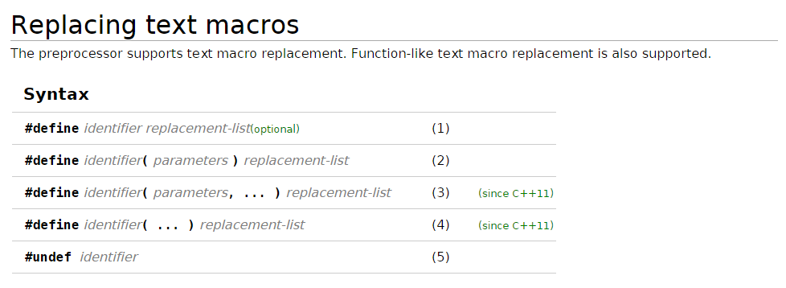
Macro Definitions

Slide 19
Simple Macros
Definition of a simple macro (or object-like macro):
#define identifier replacement-list
replacement-list is any sequence of preprocessing tokens.
The replacement list may include identifiers, keywords, numeric constants, character constants, string literals, operators, and punctuation.
Wherever identifier appears later in the file, the preprocessor substitutes replacement-list.

Slide 20
Simple Macros
Any extra symbols in a macro definition will become part of the replacement list.
Putting the = symbol in a macro definition is a common error:
#define N = 100 /*** WRONG ***/
…
int a[N]; /* int a[= 100]; */
int n N; /* int n = 100; */

Slide 21
Simple Macros
Ending a macro definition with a semicolon is another popular mistake:
#define N 100; /*** WRONG ***/
…
int a[N]; /* becomes int a[100;]; */
The compiler will detect most errors caused by extra symbols in a macro definition.
Unfortunately, the compiler will flag each use of the macro as incorrect, rather than identifying the actual culprit: the macro’s definition.

Slide 22
Simple Macros
Simple macros are primarily used for defining “manifest constants” - names that represent numeric, character, and string values:
#define STR_LEN 80
#define TRUE 1
#define FALSE 0
#define PI 3.14159
#define CR '\r'
#define EOS '\0'
#define MEM_ERR "Error: not enough memory"

Slide 23
Simple Macros
Advantages of using #define to create names for constants:
It makes programs easier to read. The name of the macro can help the reader understand the meaning of the constant.
It makes programs easier to modify. We can change the value of a constant throughout a program by modifying a single macro definition.
It helps avoid inconsistencies and typographical errors. If a numerical constant like 3.14159 appears many times in a program, chances are it will occasionally be written 3.1416 or 3.14195 by accident.

Slide 24
Simple Macros
Simple macros have additional uses.
Making minor changes to the syntax of C
Macros can serve as alternate names for C symbols:
#define BEGIN {
#define END }
#define LOOP for (;;)
Changing the syntax of C usually isn’t a good idea, since it can make programs harder for others to understand.

Slide 25
Simple Macros
Renaming types
An example from Chapter 5:
#define BOOL int
Type definitions are a better alternative.
Controlling conditional compilation
Macros play an important role in controlling conditional compilation.
A macro that might indicate “debugging mode”:
#define DEBUG

Slide 26
Simple Macros
When macros are used as constants, C programmers customarily capitalize all letters in their names.
However, there’s no consensus as to how to capitalize macros used for other purposes.
Some programmers like to draw attention to macros by using all upper-case letters in their names.
Others prefer lower-case names, following the style of K&R.

Slide 27
Parameterized Macros
Definition of a parameterized macro (also known as a function-like macro):
#define identifier( x₁, x₂, … ,x_{n} ) replacement-list
x₁, x₂, …, x_{n} are identifiers (the macro’s parameters).
The parameters may appear as many times as desired in the replacement list.
There must be no space between the macro name and the left parenthesis.
If space is left, the preprocessor will treat (x₁, x₂, …, x_{n}) as part of the replacement list.

Slide 28
Parameterized Macros
When the preprocessor encounters the definition of a parameterized macro, it stores the definition away for later use.
Wherever a macro invocation of the form identifier(y₁, y₂, …, y_{n}) appears later in the program, the preprocessor replaces it with replacement-list, substituting y₁ for x₁, y₂ for x₂, and so forth.
Parameterized macros often serve as simple functions.

Slide 29
Parameterized Macros
Examples of parameterized macros:
#define MAX(x,y) ((x)>(y)?(x):(y))
#define IS_EVEN(n) ((n)%2==0)
Invocations of these macros:
i = MAX(j+k, m-n);
if (IS_EVEN(i)) i++;
The same lines after macro replacement:
i = ((j+k)>(m-n)?(j+k):(m-n));
if (((i)%2==0)) i++;

Slide 30
Parameterized Macros
A more complicated function-like macro:
#define TOUPPER(c) \
('a'<=(c)&&(c)<='z'?(c)-'a'+'A':(c))
The <ctype.h> header provides a similar function named toupper that’s more portable.
A parameterized macro may have an empty parameter list:
#define getchar() getc(stdin)
The empty parameter list isn’t really needed, but it makes getchar resemble a function.

Slide 31
Parameterized Macros
Using a parameterized macro instead of a true function has a couple of advantages:
The program may be slightly faster. A function call usually requires some overhead during program execution, but a macro invocation does not.
Macros are “generic”. A macro can accept arguments of any type, provided that the resulting program is valid.

Slide 32
Parameterized Macros - disadvantages
Parameterized macros also have disadvantages.
The compiled code will often be larger.
Each macro invocation increases the size of the source program (and hence the compiled code).
The problem is compounded when macro invocations are nested:
n = MAX(i, MAX(j, k));
The statement after preprocessing:
n = ((i)>(((j)>(k)?(j):(k)))?(i):(((j)>(k)?(j):(k))));

Slide 33
Parameterized Macros - disadvantages
Arguments aren’t type-checked.
When a function is called, the compiler checks each argument to see if it has the appropriate type.
Macro arguments aren’t checked by the preprocessor, nor are they converted.
It’s not possible to have a pointer to a macro.
C allows pointers to functions, a useful concept.
Macros are removed during preprocessing, so there’s no corresponding notion of “pointer to a macro”.

Slide 34
Parameterized Macros - disadvantages
A macro may evaluate its arguments more than once.
Unexpected behavior may occur if an argument has side effects:
n = MAX(i++, j);
The same line after preprocessing:
n = ((i++)>(j)?(i++):(j));
If i is larger than j, then i will be (incorrectly) incremented twice and n will be assigned an unexpected value.

Slide 35
Parameterized Macros - disadvantages
Errors caused by evaluating a macro argument more than once can be difficult to find, because a macro invocation looks the same as a function call.
To make matters worse, a macro may work properly most of the time, failing only for certain arguments that have side effects.
For self-protection, it’s a good idea to avoid side effects in arguments.

Slide 36
Parameterized Macros
Parameterized macros can be used as patterns for segments of code that are often repeated.
A macro that makes it easier to display integers:
#define PRINT_INT(n) printf("%d\n", n)
The preprocessor will turn the line
PRINT_INT(i/j);
into
printf("%d\n", i/j);

Slide 37
The # Operator
Macro definitions may contain two special operators, # and ##.
Neither operator is recognized by the compiler; instead, they’re executed during preprocessing.
The # operator converts a macro argument into a string literal; it can appear only in the replacement list of a parameterized macro.
The operation performed by # is known as “stringization”.

Slide 38
The # Operator
There are a number of uses for #; let’s consider just one.
Suppose that we decide to use the PRINT_INT macro during debugging as a convenient way to print the values of integer variables and expressions.
The # operator makes it possible for PRINT_INT to label each value that it prints.

Slide 39
The # Operator
Our new version of PRINT_INT:
#define PRINT_INT(n) printf(#n " = %d\n", n)
The invocation
PRINT_INT(i/j);
will become
printf("i/j" " = %d\n", i/j);
The compiler automatically joins adjacent string literals, so this statement is equivalent to
printf("i/j = %d\n", i/j);

Slide 40
The ## Operator
The ## operator can “paste” two tokens together to form a single token.
If one of the operands is a macro parameter, pasting occurs after the parameter has been replaced by the corresponding argument.

Slide 41
The ## Operator
A macro that uses the ## operator:
#define MK_ID(n) i##n
A declaration that invokes MK_ID three times:
int MK_ID(1), MK_ID(2), MK_ID(3);
The declaration after preprocessing:
int i1, i2, i3;

Slide 42
The ## Operator
The ## operator has a variety of uses.
Consider the problem of defining a max function that behaves like the MAX macro described earlier.
A single max function usually isn’t enough, because it will only work for arguments of one type.
Instead, we can write a macro that expands into the definition of a max function.
The macro’s parameter will specify the type of the arguments and the return value.

Slide 43
The ## Operator
There’s just one snag: if we use the macro to create more than one function named max, the program won’t compile.
To solve this problem, we’ll use the ## operator to create a different name for each version of max:
#define GENERIC_MAX(type) \
type type##_max(type x, type y) \
{ \
return x > y ? x : y; \
}
An invocation of this macro:
GENERIC_MAX(float)
The resulting function definition:
float float_max(float x, float y) { return x > y ? x : y; }

Slide 44
General Properties of Macros
Several rules apply to both simple and parameterized macros.
A macro’s replacement list may contain invocations of other macros.
Example:
#define PI 3.14159
#define TWO_PI (2*PI)
When it encounters TWO_PI later in the program, the preprocessor replaces it by (2*PI).
The preprocessor then rescans the replacement list to see if it contains invocations of other macros.

Slide 45
General Properties of Macros
The preprocessor replaces only entire tokens.
Macro names embedded in identifiers, character constants, and string literals are ignored. Example:
#define SIZE 256
int BUFFER_SIZE;
if (BUFFER_SIZE > SIZE)
puts("Error: SIZE exceeded");
Appearance after preprocessing:
int BUFFER_SIZE;
if (BUFFER_SIZE > 256)
puts("Error: SIZE exceeded");

Slide 46
General Properties of Macros
A macro definition normally remains in effect until the end of the file in which it appears.
Macros don’t obey normal scope rules.
A macro defined inside the body of a function isn’t local to that function; it remains defined until the end of the file.
A macro may not be defined twice unless the new definition is identical to the old one.
Differences in spacing are allowed, but the tokens in the macro’s replacement list (and the parameters, if any) must be the same.

Slide 47
General Properties of Macros
Macros may be “undefined” by the #undef directive.
The #undef directive has the form #undef identifier where identifier is a macro name.
One use of #undef is to remove the existing definition of a macro so that it can be given a new definition.

Slide 48
Parentheses in Macro Definitions
The replacement lists in macro definitions often require parentheses in order to avoid unexpected results.
If the macro’s replacement list contains an operator, always enclose the replacement list in parentheses:
#define TWO_PI (2*3.14159)
Also, put parentheses around each parameter every time it appears in the replacement list:
#define SCALE(x) ((x)*10)
Without the parentheses, we can’t guarantee that the compiler will treat replacement lists and arguments as whole expressions.

Slide 49
Parentheses in Macro Definitions
An example that illustrates the need to put parentheses around a macro’s replacement list:
#define TWO_PI 2*3.14159
/* needs parentheses around replacement list */
During preprocessing, the statement
conversion_factor = 360/TWO_PI;
becomes
conversion_factor = 360/2*3.14159;
The division will be performed before the multiplication.

Slide 50
Parentheses in Macro Definitions
Each occurrence of a parameter in a macro’s replacement list needs parentheses as well:
#define SCALE(x) (x*10) /* needs parentheses around x */
During preprocessing, the statement
j = SCALE(i+1);
becomes
j = (i+1*10);
This statement is equivalent to
j = i+10;

Slide 51
Creating Longer Macros
The comma operator can be useful for creating more sophisticated macros by allowing us to make the replacement list a series of expressions.
A macro that reads a string and then prints it:
#define ECHO(s) (gets(s), puts(s))
Calls of gets and puts are expressions, so it’s perfectly legal to combine them using the comma operator.
We can invoke ECHO as though it were a function:
ECHO(str); /* becomes (gets(str), puts(str)); */

Slide 52
Creating Longer Macros
An alternative definition of ECHO that uses braces:
#define ECHO(s) { gets(s); puts(s); }
Suppose that we use ECHO in an if statement:
if (echo_flag)
ECHO(str);
else
gets(str);
Replacing ECHO gives the following result:
if (echo_flag)
{ gets(str); puts(str); };
else
gets(str);

Slide 53
Creating Longer Macros
The compiler treats the first two lines as a complete if statement:
if (echo_flag)
{ gets(str); puts(str); }
It treats the semicolon that follows as a null statement and produces an error message for the else clause, since it doesn’t belong to any if.
We could solve the problem by remembering not to put a semicolon after each invocation of ECHO, but then the program would look odd.

Slide 54
Creating Longer Macros
The comma operator solves this problem for ECHO, but not for all macros.
If a macro needs to contain a series of statements, not just a series of expressions, the comma operator is of no help.
The solution is to wrap the statements in a do loop whose condition is false:
do { … } while (0)
Notice that the do statement needs a semicolon at the end.

Slide 55
Creating Longer Macros
A modified version of the ECHO macro:
#define ECHO(s) \
do { \
gets(s); \
puts(s); \
} while (0)
When ECHO is used, it must be followed by a semicolon, which completes the do statement:
ECHO(str);
/* becomes
do { gets(str); puts(str); } while (0); */

Slide 56
Predefined Macros
C has several predefined macros, each of which represents an integer constant or string literal.
The __DATE__ and __TIME__ macros identify when a program was compiled.
Example of using __DATE__ and __TIME__:
printf("Compiled on %s at %s\n", __DATE__, __TIME__);
Output produced by these statements:
Compiled on Dec 23 2010 at 22:18:48
This information can be helpful for distinguishing among different versions of the same program.

Slide 57
Predefined Macros
We can use the __LINE__ and __FILE__ macros to help locate errors.
A macro that can help pinpoint the location of a division by zero:
#define CHECK_ZERO(divisor) \
if (divisor == 0) \
printf("*** Attempt to divide by zero on line %d " \
"of file %s ***\n", __LINE__, __FILE__)
The CHECK_ZERO macro would be invoked prior to a division:
CHECK_ZERO(j);
k = i / j;

Slide 58
Predefined Macros
If j happens to be zero, a message of the following form will be printed:
*** Attempt to divide by zero on line 9 of file foo.c ***
Error-detecting macros like this one are quite useful.
In fact, the C library has a general-purpose error-detecting macro named assert.
The remaining predefined macro is named __STDC__.
This macro exists and has the value 1 if the compiler conforms to the C standard (either C89 or C99).

Slide 59
Additional Predefined Macros in C99
C99 provides a few additional predefined macros.
The __STDC__HOSTED__ macro represents the constant 1 if the compiler is a hosted implementation. Otherwise, the macro has the value 0.
An implementation of C consists of the compiler plus other software necessary to execute C programs.
A hosted implementation must accept any program that conforms to the C99 standard.
A freestanding implementation doesn’t have to compile programs that use complex types or standard headers beyond a few of the most basic.

Slide 60
Additional Predefined Macros in C99
The __STDC__VERSION__ macro provides a way to check which version of the C standard is recognized by the compiler.
If a compiler conforms to the C89 standard, including Amendment 1, the value is 199409L.
If a compiler conforms to the C99 standard, the value is 199901L.

Slide 61
Additional Predefined Macros in C99
A C99 compiler will define up to three additional macros, but only if the compiler meets certain requirements:
__STDC_IEC_559__ is defined (and has the value 1) if the compiler performs floating-point arithmetic according to IEC 60559.
__STDC_IEC_559_COMPLEX__ is defined (and has the value 1) if the compiler performs complex arithmetic according to IEC 60559.
__STDC_ISO_10646__ is defined as yyyymmL if wide characters are represented by the codes in ISO/IEC 10646 (with revisions as of the specified year and month).

Slide 62
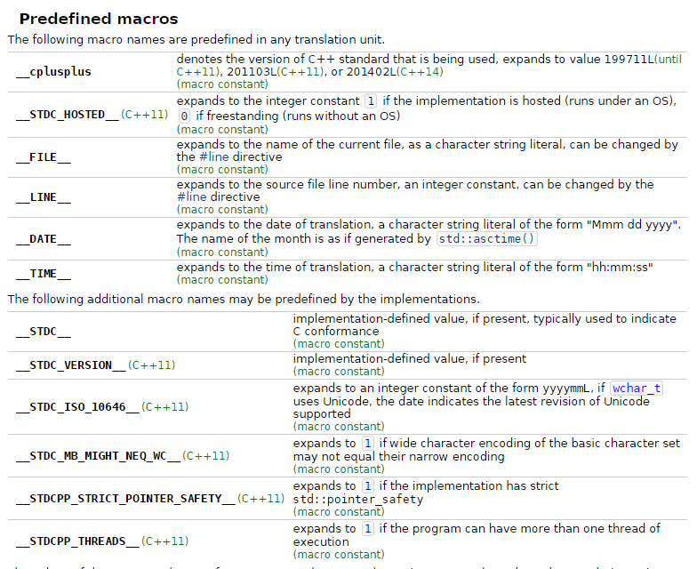

Slide 63
Empty Macro Arguments (C99)
C99 allows any or all of the arguments in a macro call to be empty.
Such a call will contain the same number of commas as a normal call.
Wherever the corresponding parameter name appears in the replacement list, it’s replaced by nothing.

Slide 64
Empty Macro Arguments (C99)
Example:
#define ADD(x,y) (x+y)
After preprocessing, the statement
i = ADD(j,k);
becomes
i = (j+k);
Whereas the statement
i = ADD(,k);
becomes
i = (+k);

Slide 65
Empty Macro Arguments (C99)
When an empty argument is an operand of the # or ## operators, special rules apply.
If an empty argument is “stringized” by the # operator, the result is "" (the empty string):
#define MK_STR(x) #x
…
char empty_string[] = MK_STR();
The declaration after preprocessing:
char empty_string[] = "";

Slide 66
Empty Macro Arguments (C99)
If one of the arguments of the ## operator is empty, it’s replaced by an invisible “placemarker” token.
Concatenating an ordinary token with a placemarker token yields the original token (the placemarker disappears).
If two placemarker tokens are concatenated, the result is a single placemarker.
Once macro expansion has been completed, placemarker tokens disappear from the program.

Slide 67
Empty Macro Arguments (C99)
Example:
#define JOIN(x,y,z) x##y##z
…
int JOIN(a,b,c), JOIN(a,b,), JOIN(a,,c), JOIN(,,c);
The declaration after preprocessing:
int abc, ab, ac, c;
The missing arguments were replaced by placemarker tokens, which then disappeared when concatenated with any nonempty arguments.
All three arguments to the JOIN macro could even be missing, which would yield an empty result.

Slide 68
Macros with a Variable Number of Arguments (C99)
C99 allows macros that take an unlimited number of arguments.
A macro of this kind can pass its arguments to a function that accepts a variable number of arguments.
Example:
#define TEST(condition, ...) ((condition)? \
printf("Passed test: %s\n", #condition): \
printf(__VA_ARGS__))
The ... token (ellipsis) goes at the end of the parameter list, preceded by ordinary parameters, if any.
__VA_ARGS__ is a special identifier that represents all the arguments that correspond to the ellipsis.

Slide 69
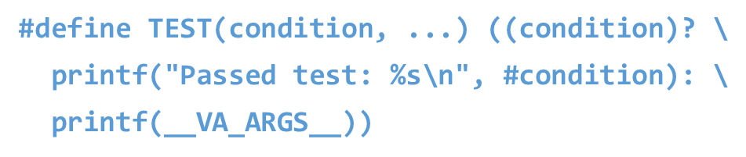
Macros with a Variable Number of Arguments (C99)
An example that uses the TEST macro:
TEST(voltage <= max_voltage,
"Voltage %d exceeds %d\n", voltage, max_voltage);
Preprocessor output (reformatted for readability):
((voltage <= max_voltage)?
printf("Passed test: %s\n", "voltage <= max_voltage"):
printf("Voltage %d exceeds %d\n", voltage, max_voltage));
The program will display the message if voltage is no more than max_voltage.
Passed test: voltage <= max_voltage
Otherwise, it will display the values of voltage and max_voltage:
Voltage 125 exceeds 120

Slide 70
The __func__ Identifier (C99)
The __func__ identifier behaves like a string variable that stores the name of the currently executing function.
The effect is the same as if each function contains the following declaration at the beginning of its body:
static const char __func__[] = "function-name";
where function-name is the name of the function.

Slide 71
The __func__ Identifier (C99)
Debugging macros that rely on the __func__ identifier:
#define FUNCTION_CALLED() printf("%s called\n", __func__);
#define FUNCTION_RETURNS() printf("%s returns\n", __func__);
These macros can used to trace function calls:
void f(void)
{
FUNCTION_CALLED(); /* displays "f called" */
…
FUNCTION_RETURNS(); /* displays "f returns" */
}
Another use of __func__: it can be passed to a function to let it know the name of the function that called it.

Slide 72
01) | #include <stdio.h>
02) | #define STRING1 "A macro definition\n"
03) | #define STRING2 "must be all on one line!\n"
04) | #define EXPRESSION1 1 + 2 + 3 + 4
05) | #define EXPRESSION2 EXPRESSION1 + 10
06) | #define ABS(x) (((x) < 0) ? -(x) : (x))
07) | #define MAX(a,b) ((a < b) ? (b) : (a))
08) | #define BIGGEST(a,b,c) ((MAX(a,b) < c) ? (c) : (MAX(a,b)))
09) | int main ()
10) | {
11) | printf (STRING1);
12) | printf (STRING2);
13) | printf ("%d\n", EXPRESSION1);
14) | printf ("%d\n", EXPRESSION2);
15) | printf ("%d\n", ABS(-5));
16) | printf ("Biggest of 1, 2, and 3 is %d\n", BIGGEST(1,2,3));
17) | return 0;
18) | }
A macro definition
must be all on one line!
10
20
5
Biggest of 1, 2, and 3 is 3

Slide 73
Conditional Compilation
The C preprocessor recognizes a number of directives that support conditional compilation.
This feature permits the inclusion or exclusion of a section of program text depending on the outcome of a test performed by the preprocessor.

Slide 74
The #if and #endif Directives
Suppose we’re in the process of debugging a program.
We’d like the program to print the values of certain variables, so we put calls of printf in critical parts of the program.
Once we’ve located the bugs, it’s often a good idea to let the printf calls remain, just in case we need them later.
Conditional compilation allows us to leave the calls in place, but have the compiler ignore them.

Slide 75
The #if and #endif Directives
The first step is to define a macro and give it a nonzero value:
#define DEBUG 1
Next, we’ll surround each group of printf calls by an #if-#endif pair:
#if DEBUG
printf("Value of i: %d\n", i);
printf("Value of j: %d\n", j);
#endif

Slide 76
The #if and #endif Directives
During preprocessing, the #if directive will test the value of DEBUG.
Since its value isn’t zero, the preprocessor will leave the two calls of printf in the program.
If we change the value of DEBUG to zero and recompile the program, the preprocessor will remove all four lines from the program.
The #if-#endif blocks can be left in the final program, allowing diagnostic information to be produced later if any problems turn up.

Slide 77
The #if and #endif Directives
General form of the #if and #endif directives:
#if constant-expression
#endif
When the preprocessor encounters the #if directive, it evaluates the constant expression.
If the value of the expression is zero, the lines between #if and #endif will be removed from the program during preprocessing.
Otherwise, the lines between #if and #endif will remain.

Slide 78
The #if and #endif Directives
The #if directive treats undefined identifiers as macros that have the value 0.
If we neglect to define DEBUG, the test
#if DEBUG
will fail (but not generate an error message).
The test
#if !DEBUG
will succeed.

Slide 79
The defined Operator
The preprocessor supports three operators: #, ##, and defined.
When applied to an identifier, defined produces the value 1 if the identifier is a currently defined macro; it produces 0 otherwise.
The defined operator is normally used in conjunction with the #if directive.

Slide 80
The defined Operator
Example:
#if defined(DEBUG)
…
#endif
The lines between #if and #endif will be included only if DEBUG is defined as a macro.
The parentheses around DEBUG aren’t required:
#if defined DEBUG
It’s not necessary to give DEBUG a value:
#define DEBUG

Slide 81
The #ifdef and #ifndef Directives
The #ifdef directive tests whether an identifier is currently defined as a macro:
#ifdef identifier
The effect is the same as
#if defined(identifier)
The #ifndef directive tests whether an identifier is not currently defined as a macro:
#ifndef identifier
The effect is the same as
#if !defined(identifier)

Slide 82
The #elif and #else Directives
#if, #ifdef, and #ifndef blocks can be nested just like ordinary if statements.
When nesting occurs, it’s a good idea to use an increasing amount of indentation as the level of nesting grows.
Some programmers put a comment on each closing #endif to indicate what condition the matching #if tests:
#if DEBUG
…
#endif /* DEBUG */

Slide 83
The #elif and #else Directives
#elif and #else can be used in conjunction with #if, #ifdef, or #ifndef to test a series of conditions:
#if expr1
Lines to be included if expr1 is nonzero
#elif expr2
Lines to be included if expr1 is zero but expr2 is nonzero
#else
Lines to be included otherwise
#endif
Any number of #elif directives - but at most one #else - may appear between #if and #endif.

Slide 84
Uses of Conditional Compilation
Conditional compilation has other uses besides debugging.
Writing programs that are portable to several machines or operating systems.
Example:
#if defined(WIN32)
…
#elif defined(MAC_OS)
…
#elif defined(LINUX)
…
#endif

Slide 85
Uses of Conditional Compilation
Writing programs that can be compiled with different compilers.
An example that uses the __STDC__ macro:
#if __STDC__
Function prototypes
#else
Old-style function declarations
#endif
If the compiler does not conform to the C standard, old-style function declarations are used instead of function prototypes.

Slide 86
Uses of Conditional Compilation
Providing a default definition for a macro.
Conditional compilation makes it possible to check whether a macro is currently defined and, if not, give it a default definition:
#ifndef BUFFER_SIZE
#define BUFFER_SIZE 256
#endif

Slide 87
Uses of Conditional Compilation
Temporarily disabling code that contains comments.
A /*…*/ comment can’t be used to “comment out” code that already contains /*…*/ comments.
An #if directive can be used instead:
#if 0
Lines containing comments
#endif

Slide 88
Uses of Conditional Compilation
Chapter 15 discusses another common use of conditional compilation: protecting header files against multiple inclusion.

Slide 89
01) | #if DLEVEL > 5
02) | #define SIGNAL 1
03) | #if STACKUSE == 1
04) | #define STACK 200
05) | #else
06) | #define STACK 100
07) | #endif
08) | #else
09) | #define SIGNAL 0
10) | #if STACKUSE == 1
11) | #define STACK 100
12) | #else
13) | #define STACK 50
14) | #endif
15) | #endif
01) | #if DLEVEL == 0
02) | #define STACK 0
03) | #elif DLEVEL == 1
04) | #define STACK 100
05) | #elif DLEVEL > 5
06) | display( debugptr );
07) | #else
08) | #define STACK 200
09) | #endif

Slide 90
Miscellaneous Directives
The #error, #line, and #pragma directives are more specialized than the ones we’ve already examined.
These directives are used much less frequently.

Slide 91
The #error Directive
Form of the #error directive:
#error message
message is any sequence of tokens.
If the preprocessor encounters an #error directive, it prints an error message which must include message.
If an #error directive is processed, some compilers immediately terminate compilation without attempting to find other errors.

Slide 92
The #error Directive
#error directives are frequently used in conjunction with conditional compilation.
Example that uses an #error directive to test the maximum value of the int type:
#if INT_MAX < 100000
#error int type is too small
#endif

Slide 93
The #error Directive
The #error directive is often found in the #else part of an #if-#elif-#else series:
#if defined(WIN32)
…
#elif defined(MAC_OS)
…
#elif defined(LINUX)
…
#else
#error No operating system specified
#endif

Slide 94
The #line Directive
The #line directive is used to alter the way program lines are numbered.
First form of the #line directive:
#line n
Subsequent lines in the program will be numbered n, n + 1, n + 2, and so forth.
Second form of the #line directive:
#line n "file"
Subsequent lines are assumed to come from file, with line numbers starting at n.

Slide 95
The #line Directive
The #line directive changes the value of the __LINE__ macro (and possibly __FILE__).
Most compilers will use the information from the #line directive when generating error messages.
Suppose that the following directive appears at the beginning of foo.c:
#line 10 "bar.c"
If the compiler detects an error on line 5 of foo.c, the message will refer to line 10 of file bar.c.
The #line directive is used primarily by programs that generate C code as output.

Slide 96
#line 314 "pi.c"
printf("line=%d file=%s\n", __LINE__, __FILE__);
Generates the printf function:
printf("line=%d file=%s\n", 314, "pi.c");

Slide 97
The #line Directive
The most famous example is yacc (Yet Another Compiler-Compiler), a UNIX utility that automatically generates part of a compiler.
The programmer prepares a file that contains information for yacc as well as fragments of C code.
From this file, yacc generates a C program, y.tab.c, that incorporates the code supplied by the programmer.
By inserting #line directives, yacc tricks the compiler into believing that the code comes from the original file.
Error messages produced during the compilation of y.tab.c will refer to lines in the original file.

Slide 98
The #pragma Directive
The #pragma directive provides a way to request special behavior from the compiler.
Form of a #pragma directive:
#pragma tokens
#pragma directives can be very simple (a single token) or they can be much more elaborate:
#pragma data(heap_size => 1000, stack_size => 2000)

Slide 99
The #pragma Directive
The set of commands that can appear in #pragma directives is different for each compiler.
The preprocessor must ignore any #pragma directive that contains an unrecognized command; it’s not permitted to give an error message.
In C89, there are no standard pragmas - they’re all implementation-defined.
C99 has three standard pragmas, all of which use STDC as the first token following #pragma.

Slide 100
The _Pragma Operator (C99)
C99 introduces the _Pragma operator, which is used in conjunction with the #pragma directive.
A _Pragma expression has the form
_Pragma ( string-literal )
When it encounters such an expression, the preprocessor “destringizes” the string literal:
Double quotes around the string are removed.
\" is replaced by ".
\\ is replaced by \.

Slide 101
The _Pragma Operator (C99)
The resulting tokens are then treated as though they appear in a #pragma directive.
For example, writing
_Pragma("data(heap_size => 1000, stack_size => 2000)")
is the same as writing
#pragma data(heap_size => 1000, stack_size => 2000)

Slide 102
The _Pragma Operator (C99)
The _Pragma operator lets us work around the fact that a preprocessing directive can’t generate another directive.
_Pragma, however, is an operator, not a directive, and can therefore appear in a macro definition.
This makes it possible for a macro expansion to leave behind a #pragma directive.

Slide 103
The _Pragma Operator (C99)
A macro that uses the _Pragma operator:
#define DO_PRAGMA(x) _Pragma(#x)
An invocation of the macro:
DO_PRAGMA(GCC dependency "parse.y")
The result after expansion:
#pragma GCC dependency "parse.y"
The tokens passed to DO_PRAGMA are stringized into "GCC dependency \"parse.y\"".
The _Pragma operator destringizes this string, producing a #pragma directive.

Slide 104
#pragma once // header file code
In this example, using #pragma once is equivalent to an include guard that prevents the file from being processed multiple times.
#ifndef _FILE_NAME_H_
#define _FILE_NAME_H_
…
/* code */
…
#endif // #ifndef _FILE_NAME_H_

Slide 105
#pragma warning (disable : 4018 )
Can be used to disable warning 4018, warning of signed/unsigned mismatch. While you should be reluctant to suppress warnings sometimes it is necessary.
For more uses of the #pragma directive, consult your compiler's documentation.

